Slide 1
Creating
Dashboards
Creating
Dashboards

Slide 2
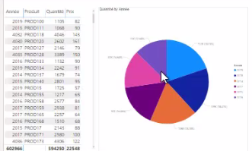
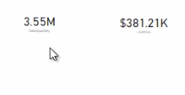
Creating Dashboards
Note: This lab requires a Power BI Services account with administrator privileges
Start by loading the SalesExcel.xlsx file as a DataSet in Power BI Service
Load the DataSet into the Report Editor at the Power BI Services level
Add some visuals to create two test reports from this DataSet

Slide 3

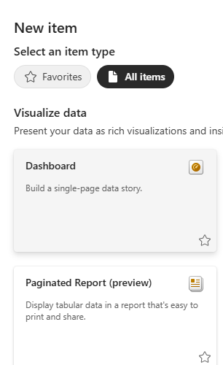
Creating Dashboards
Save both reports in the workspace
Click button at the workspace level and then select Dashboard

Slide 4
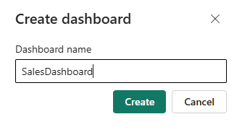
Creating Dashboards
Name the Dashboard

Slide 5
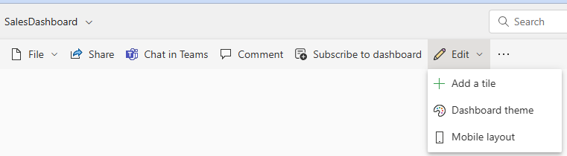
Creating Dashboards
Click Edit and then Add a tile

Slide 6
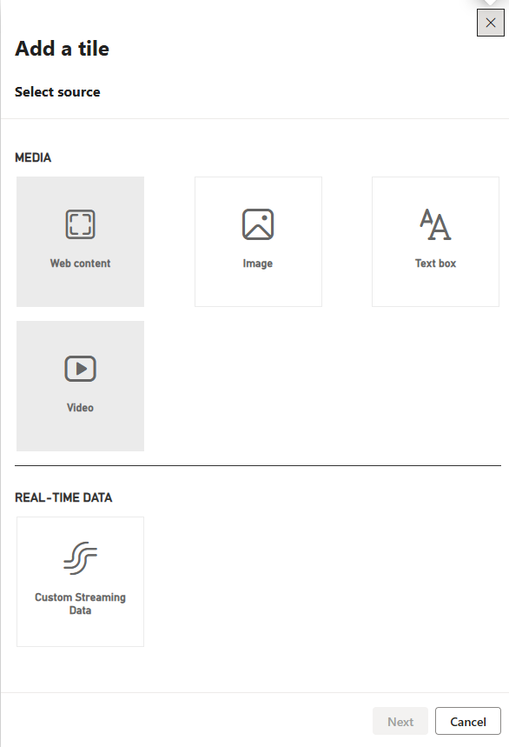
Creating Dashboards
Explore the items that can be added to the Dashboard

Slide 7
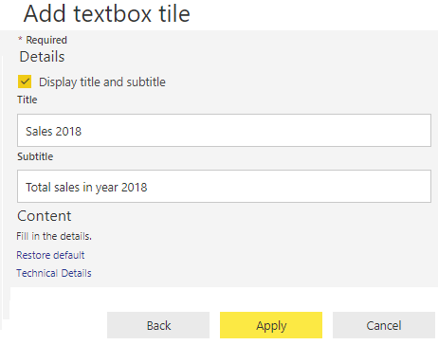
Creating Dashboards
Add Text box element to add a title

Slide 8
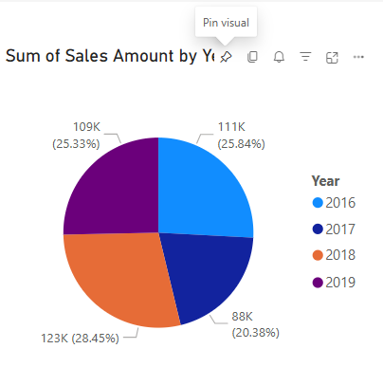
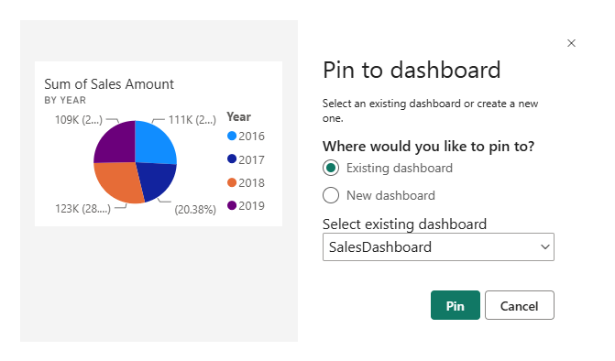
Creating Dashboards
To return to one of the reports and select one of the visuals, click the icon Pin the visual
Select the Existing Visual radio button and then select the Dashboard previously from the Select existing drop-down list dashboard

Slide 9
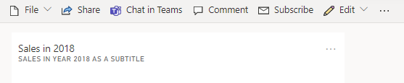
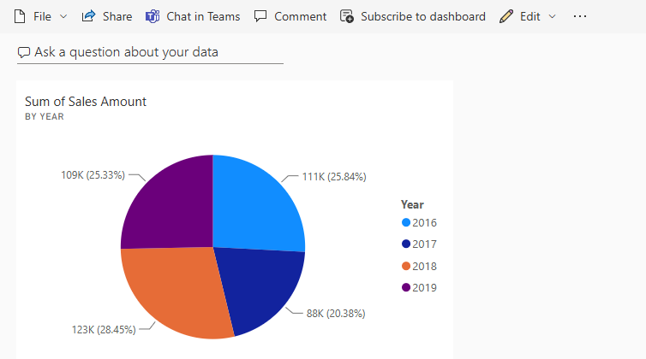
Creating Dashboards
Continue to add some visuals from many other reports
Go around the menu visible at the top
Before
After

Slide 10
Thank you
Thank you

